Slide 1
Basic Details of the Team and Problem Statement
Ministry/Organization Name/Student Innovation:
Department of Administrative Reforms and Public Grievances in the Union Ministry of Personnel.
Problem Statement Title: Chat-Bot to help the citizens to resolve their queries and assist while filling the Grievances on CPGRAM portal .
Team Name: PHOENIX FURY
Team Leader Name: Priyanka Bhusari
Institute Name: P.R. Pote Patil College of Engineering and Management, Amravati
Theme Name: Smart Automation

Slide 2
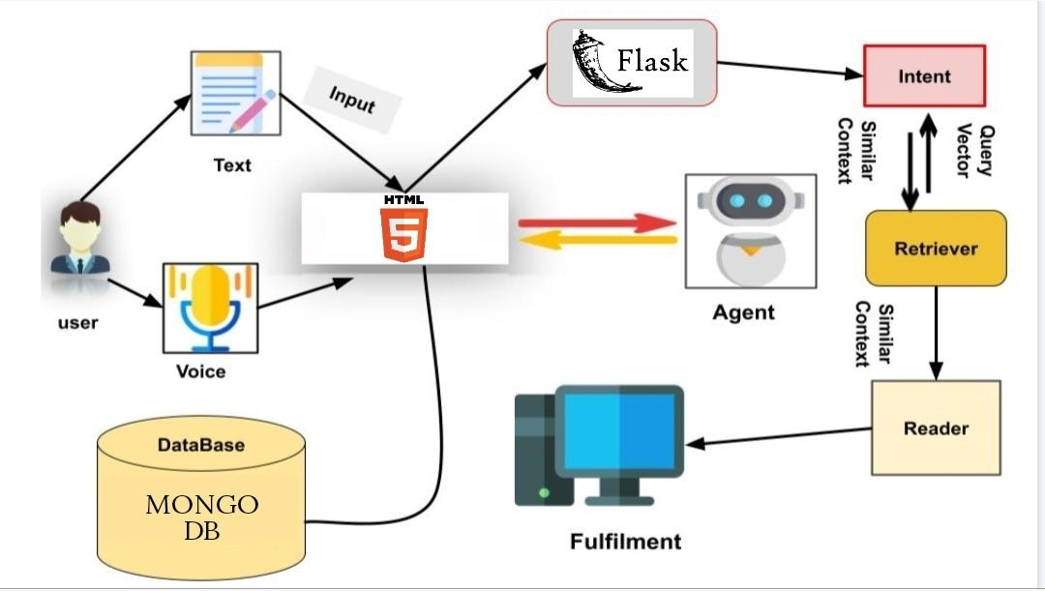





Idea/Approach Details
Describe your idea/Solution/Prototype here:
By giving an AI based chat-bot .we are improving the grievance CPGRAM portal of GOI(Government of India) , which will make easier process to make Grievance and get a follow-up on it .
According to the inception of CPGRAMS (Centralised Public Grievance Redress and Monitoring System) under the Department of Administrative Reforms and Public Grievances in the Union Ministry of Personnel. Government's Grievance redressal rate has crossed 1lakh cases per month
We're building a AI based chat-bot help the citizens while filling the Grievances . This AI based chat-bot track the status and update the unique ID’s .
Features of the application :
Selecting the available particular Ministry and the Department based on the Grievances .
This chat-bot were provides and automated options using Dialog-flow.
This AI applications will use efficient gateway for the citizen to effectively manage their Grievances with the help of unique ID’s.
Implement user authentication mechanisms to ensure that only authorized users can access sensitive information or perform certain actions within the chatbot interface.
Describe your Technology stack here:
Flask
HTML
CSS
Mongodb
Javascript
:2

Slide 3
Idea/Approach Details
Describe your Dependencies / Show stopper hear
Describe your Use Cases here
Data Availability: Access to a comprehensive dataset of grievances, including past submissions, resolutions, and user interactions, is crucial for training machine learning models and building a knowledge base for the chatbot.
Integration with CPGRAM Portal: Seamless integration with the CPGRAM portal is essential to retrieve real-time data.
Dialog Management: Developing an effective dialog management system is crucial for guiding users through the grievance filing process, handling user interactions, and providing relevant responses.
User Authentication and Security: Implementing mechanisms for user authentication and ensuring data security and privacy are essential considerations, especially when handling sensitive information such as personal details and grievance submissions.
Collaboration with Stakeholders: Establishing strong collaboration and communication channels with stakeholders, including government agencies, CPGRAM administrators.
Accessibility and Usability: Ensuring the chatbot interface is accessible to users with disabilities and adheres to usability principles is essential for providing an inclusive and user-friendly experience.
Domain Knowledge and Expertise: Acquiring domain knowledge about the CPGRAM portal, grievance filing processes, relevant government policies, and procedures is crucial for designing effective user interactions and providing accurate assistance.
For Citizens (Drivers)
Users need to register the portal and log-in to the site and fill the Grievance .
Receive real-time updates on the status and track the fill up Grievance .
For Ministry Administrators (Officials)
Monitoring incoming Grievances in real-time and analyze the status of the particular users.
Administrative have the permissions to use the details of a users and take the respective actions .
Identify areas with high demand for Grievances according to the respective departments
Identify the areas where parking is congested and improve parking availability in those areas
For Department Administrators.
Monitor all the issues regarding to the grievances.
They have the authority to update the status and take the follow-up for each user .
Troubleshoot issues reported by users.

Slide 4
Team Member Details
Team Leader Name: Priyanka Bhusari
Branch: B.E Stream: AI&DS Year: III
Team Member 1 Name: Yashswi Gandhak
Branch: B.E. Stream: AI&DS Year: III
Team Member 2 Name: Shivam Lad
Branch: B.E Stream: AI&DS Year: III
Team Member 3 Name: Disha Dhanraj Patil
Branch: B.Tech. Stream: AI&DS Year: I
Team Member 4 Name: Vinay Kakad
Branch: B.E Stream: AI&DS Year: III
Team Mentor 1 Name: Prof. A. R. Ladole
Category: Academic Expertise: AI&ML Domain Experience: 10

